Slide 1
CS210
Algorithms and Data Structures
Introduction to MonteCarlo Simulation
Week 10
Semester 1 2025
Dr. Pierpaolo Dondio

Slide 2

Week 10
Motivation
Definition and key properties of MM simulation
Example of Applications
Java Implementation(s)

Slide 3
Why MM simulations?
Remember heuristics?
We are not interested in finding the exact solution, we are interested in approximating it and understand how far we are from the actual solution
Some problems might not have an explicit solution (or we have not solved them yet)
Some problems have a solution, but it is too hard to compute
Montecarlo simulations are useful in these cases

Slide 4
Definition of MM simulation
Monte Carlo Simulation is a computational technique that uses random sampling to estimate numerical results.
Key points:
It is used when analytical solutions are difficult or impossible.
It relies on repeated random experiments to approximate probabilities, averages, or other statistical quantities.
The accuracy of the estimate improves with the number of simulations.
Common applications include:
Estimating areas or integrals
Probabilities in games of chance
Risk assessment in finance and engineering
Simulating complex systems with randomness

Slide 5
Basics
System: The physical process of interest
Model: Mathematical representation of the system
Models are a fundamental tool of science, engineering, business, etc.
Abstraction of reality
Models always have limits of credibility
Simulation: A type of model where the computer is used to imitate the behavior of the system
Monte Carlo simulation: Simulation that makes use of internally generated (pseudo) random numbers

Slide 6
Ways to Study System
System
Experiment w/ actual system
Experiment w/ model of system
Physical
Model
Mathematical
Model
Analytical
Model
Simulation
Model
Our Focus

Slide 7
Advantages of Simulation
Often the only type of model possible for complex systems
Analytical models based on exact solution frequently infeasible
Process of building simulation can clarify understanding of real system
Sometimes more useful than actual application of final simulation
Allows for sensitivity analysis and optimization of real system without need to operate real system
Can maintain better control over experimental conditions than real system
Time compression/expansion: Can evaluate system on slower or faster time scale than real system

Slide 8
Some Disadvantages of Simulation
May be very expensive and time consuming to build simulation
Easy to misuse simulation by “stretching” it beyond the limits of credibility
Problem especially apparent when using commercial simulation packages due to ease of use and lack of familiarity with underlying assumptions and restrictions
Slick graphics, animation, tables, etc. may tempt user to assign unwarranted credibility to output
Monte Carlo simulation usually requires several (perhaps many) runs at given input values
Contrast: analytical solution provides exact values

Slide 9
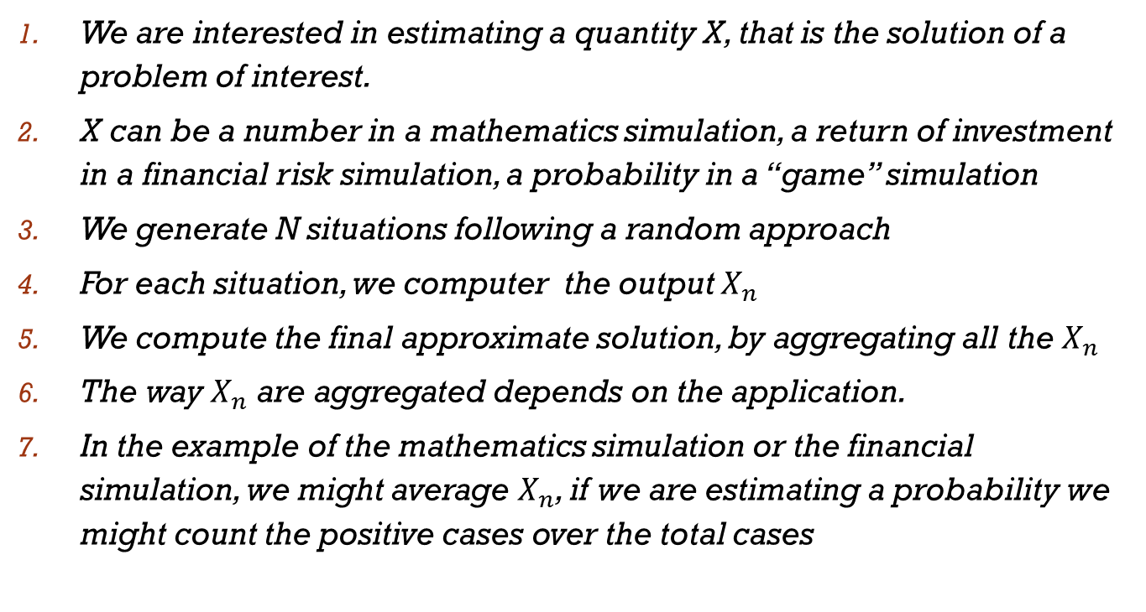
Basic Approach
We are interested in estimating a quantity X, that is the solution of a problem of interest.
X can be a number in a mathematics simulation, a return of investment in a financial risk simulation, a probability in a “game” simulation
We generate N situations following a random approach
For each situation, we computer the output $X_{n}$
We compute the final approximate solution, by aggregating all the $X_{n}$
The way $X_{n}$ are aggregated depends on the application.
In the example of the mathematics simulation or the financial simulation, we might average $X_{n}$, if we are estimating a probability we might count the positive cases over the total cases

Slide 10
Example
What is the probability to get a poker at Texas Hold’em poker?
Select the number of simulations N (=trials)
Repeat N times:
Shuffle the deck (randomness is here!)
Pick 7 cards
Check if there is a poker
Count all the times a poker was present, call it P
The final probability is P / N (positive cases divided by the total number of cases)

Slide 11
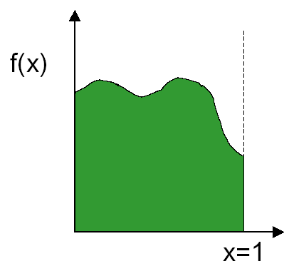
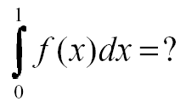
Example: integral of a function
How to evaluate the integral of f(x)?
For some integrals there is no solution, only an estimated value…

Slide 12
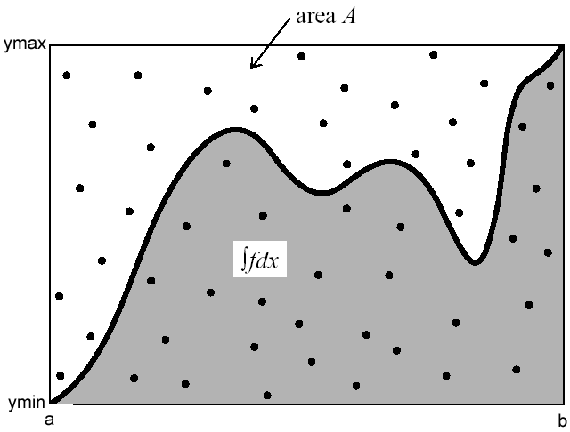
Example: integral of a function
Idea: generate random points and check how many are below the curve of the function (grey area)
Estimate the area based on the portion of points in the grey area

Slide 13
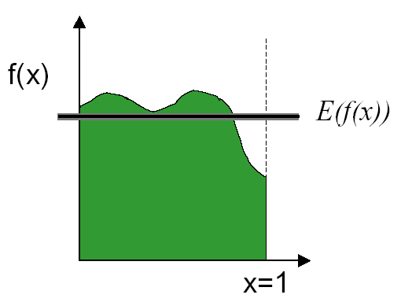
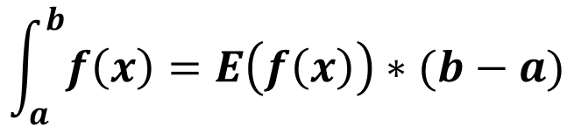
Another possible MM approach
We can approximate by taking the average or the expected value
$$\int_{a}^{b}{f\left(x\right)=E\left(f\left(x\right)\right)∗(b−a)}$$
a b

Slide 14
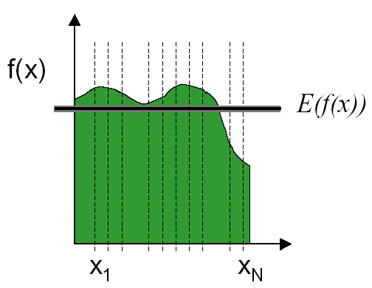
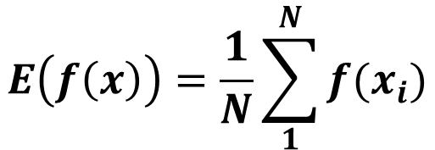
Estimate the average E(f(x))
We can estimate the average E(f(x)) using MM simulation
We take N points and we average them to estimate E(f(x))
$$E\left(f\left(x\right)\right)=\frac{1}{N}\sum_{1}^{N}{f(x_{i})}$$

Slide 15
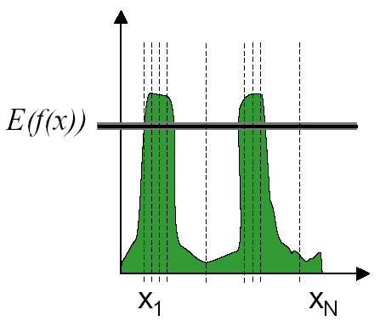
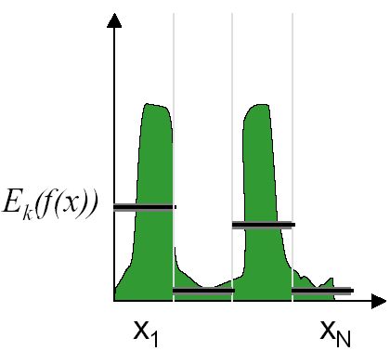
A better way of sampling
Instead of creating sample simulation completely random, there are other ways that can reduce the error of the simulations
Important Sampling: Sample more in the functions have more important values
Stratified Sampling: Partition the range of data into smaller domains intervals and apply MM simulation to each of them

Slide 16
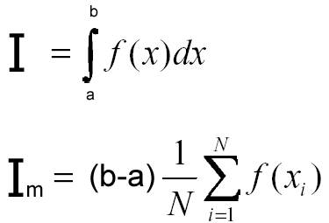

MonteCarlo integration
I_{m} = Monte Carlo estimate
N = number of samples
x₁, x₂, …, x_{N} are uniformly distributed random numbers between a and b
The more simulations, the better is the estimate

Slide 17
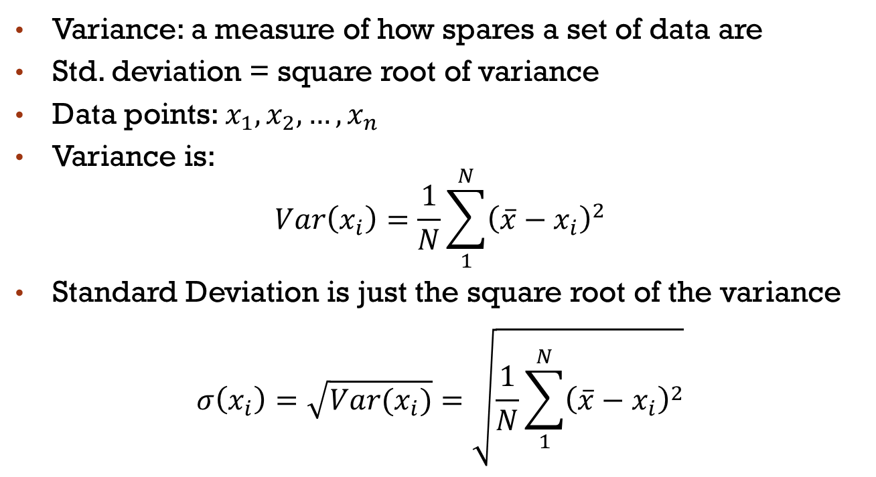
Recap: variance and std. deviation
Variance: a measure of how spares a set of data are
Std. deviation = square root of variance
Data points: $x_{1},x_{2},…,x_{n}$
Variance is:
$$Var\left(x_{i}\right)=\frac{1}{N}\sum_{1}^{N}{{\left(\overline{x}−x_{i}\right)}^{2}}$$
Standard Deviation is just the square root of the variance
$$σ\left(x_{i}\right)=\sqrt{Var(x_{i})}=\sqrt{\frac{1}{N}\sum_{1}^{N}{{\left(\overline{x}−x_{i}\right)}^{2}}}$$

Slide 18
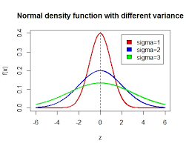
Variance
What set of points have higher variance? (the mean is the same)
mean
mean

Slide 19
How many samples do we need?
Each time we rerun the Monte Carlo we get different results due to the inherent randomness
How much confidence can we put on our estimates? How many samples do we need?
Intuitions: the more sample, the surer about our estimate we are
It also depends how different are the outputs of each simulation (=the variance of the simulations).
If they are pretty close to each other, we are more confident and we might need less trials
If they change dramatically, we might need more trials to be confident

Slide 20

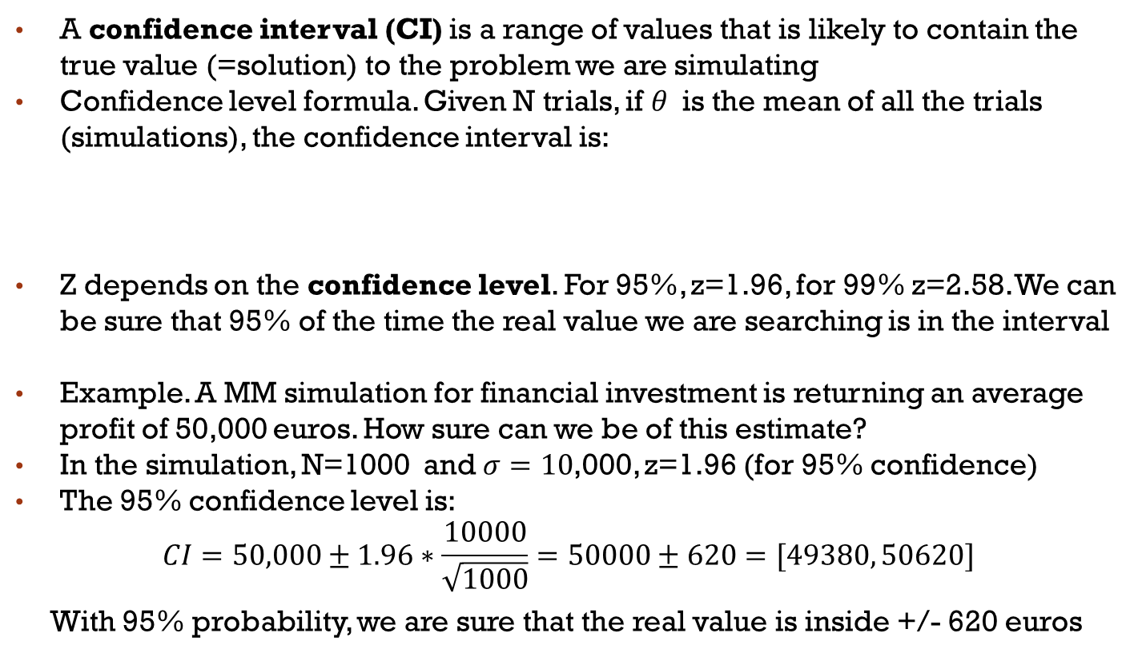
Confidence interval
A confidence interval (CI) is a range of values that is likely to contain the true value (=solution) to the problem we are simulating
Confidence level formula. Given N trials, if $θ$is the mean of all the trials (simulations), the confidence interval is:
Z depends on the confidence level. For 95%, z=1.96, for 99% z=2.58. We can be sure that 95% of the time the real value we are searching is in the interval
Example. A MM simulation for financial investment is returning an average profit of 50,000 euros. How sure can we be of this estimate?
In the simulation, N=1000 and $σ=10$,000, z=1.96 (for 95% confidence)
The 95% confidence level is:
$$CI=50,000±1.96∗\frac{10000}{\sqrt{1000}}=50000±620=[49380, 50620]$$
With 95% probability, we are sure that the real value is inside +/- 620 euros
$$CI=θ±z ∗\frac{σ}{√(N) }$$

Slide 21
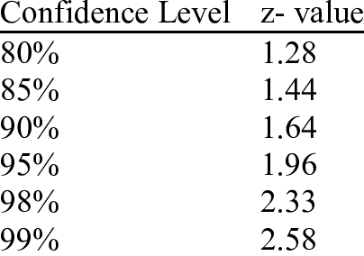
Values of z by confidence level

Slide 22
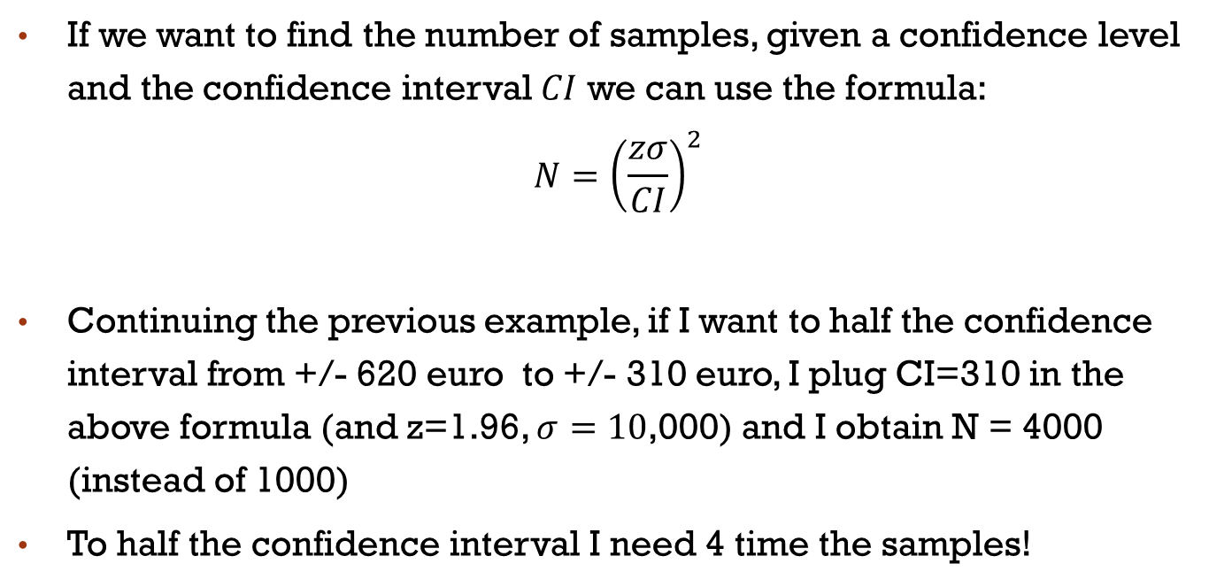
Confidence interval and variance
If we want to find the number of samples, given a confidence level and the confidence interval $CI$ we can use the formula:
$$N={\left(\frac{zσ}{CI}\right)}^{2}$$
Continuing the previous example, if I want to half the confidence interval from +/- 620 euro to +/- 310 euro, I plug CI=310 in the above formula (and z=1.96, $σ=10$,000) and I obtain N = 4000 (instead of 1000)
To half the confidence interval I need 4 time the samples!

Slide 23
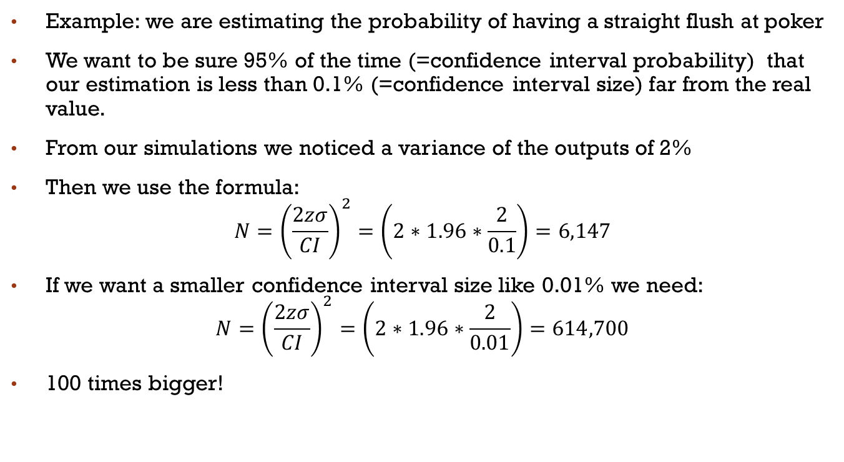
Example /2
Example: we are estimating the probability of having a straight flush at poker
We want to be sure 95% of the time (=confidence interval probability) that our estimation is less than 0.1% (=confidence interval size) far from the real value.
From our simulations we noticed a variance of the outputs of 2%
Then we use the formula:
$$N={\left(\frac{2zσ}{CI}\right)}^{2}=\left(2∗1.96∗\frac{2}{0.1}\right)=6,147$$
If we want a smaller confidence interval size like 0.01% we need:
$$N={\left(\frac{2zσ}{CI}\right)}^{2}=\left(2∗1.96∗\frac{2}{0.01}\right)=614,700$$
100 times bigger!

Slide 24
MM Simulation Examples
Greek PI
Throw 10 dices and get number 25
Probability of getting a 4-of-a-kind at Poker

Slide 25
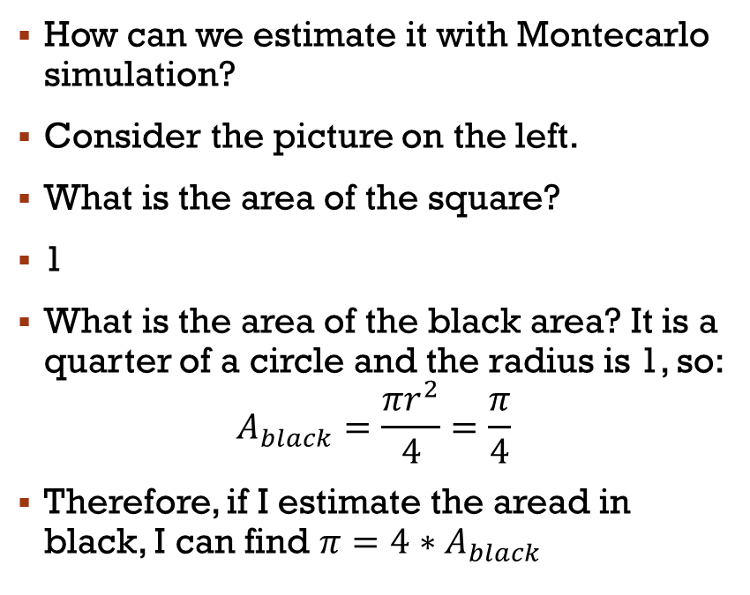

Estimating GREEK PI ($π$) via MM
1
1,1
How can we estimate it with Montecarlo simulation?
Consider the picture on the left.
What is the area of the square?
1
What is the area of the black area? It is a quarter of a circle and the radius is 1, so:
$$A_{black}=\frac{πr^{2}}{4}=\frac{π}{4}$$
Therefore, if I estimate the aread in black, I can find $π=4∗A_{black}$
0
1

Slide 26
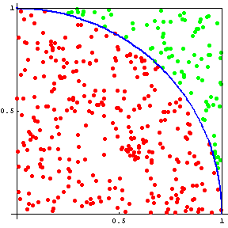
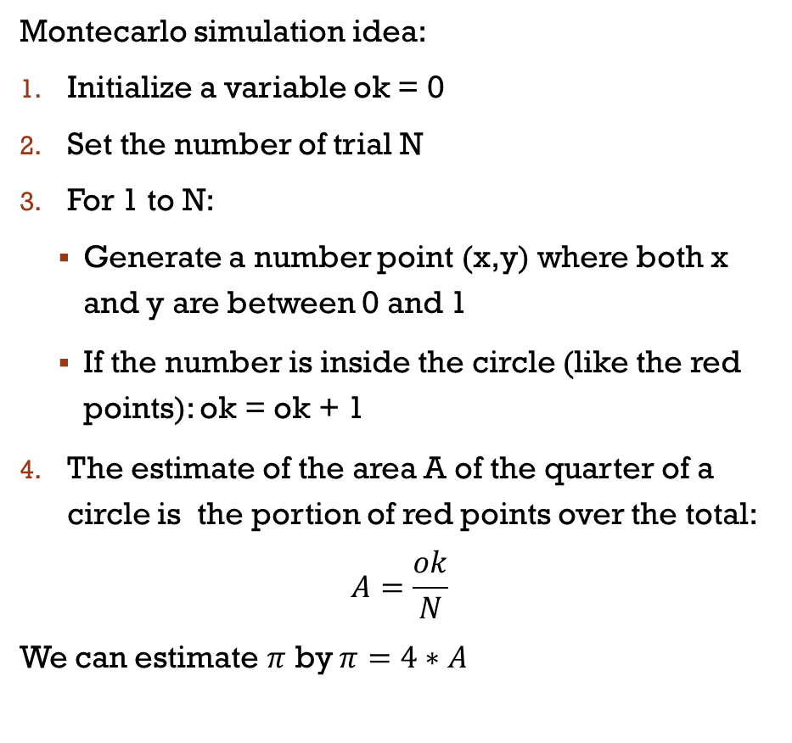

GREEK PI ($π$)
Montecarlo simulation idea:
Initialize a variable ok = 0
Set the number of trial N
For 1 to N:
Generate a number point (x,y) where both x and y are between 0 and 1
If the number is inside the circle (like the red points): ok = ok + 1
The estimate of the area A of the quarter of a circle is the portion of red points over the total:
$$A=\frac{ok}{N}$$
We can estimate $π$ by $π=4∗A$

Slide 27
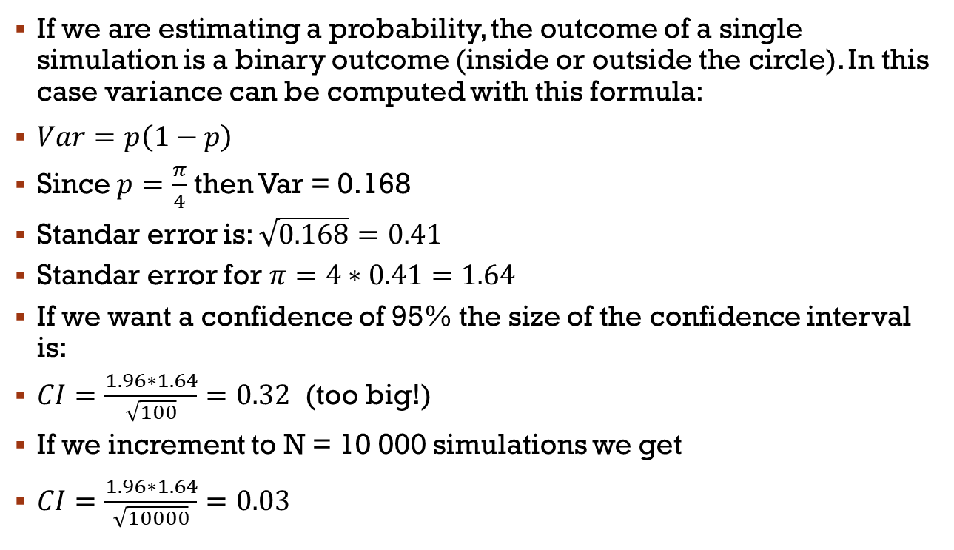
CONFIDENCE INTERVAL
If we are estimating a probability, the outcome of a single simulation is a binary outcome (inside or outside the circle). In this case variance can be computed with this formula:
$Var=p\left(1−p\right)$
Since $p=\frac{π}{4}$ then Var = 0.168
Standar error is: $\sqrt{0.168}=0.41$
Standar error for $π=4∗0.41=1.64$
If we want a confidence of 95% the size of the confidence interval is:
$CI=\frac{1.96∗1.64}{\sqrt{100}}=0.32$ (too big!)
If we increment to N = 10 000 simulations we get
$CI=\frac{1.96∗1.64}{\sqrt{10000}}=0.03$

Slide 28
Probability to throw Dice
What is the probability of getting 25 by throwing 10 dices?
Roll ten 6 sided die N times.
Compute the sum of all the dice
Count the number of time you get a 25, call it count_25
Estimate the probability as count_25/N.

Slide 29

Probability of a Straight Flush
What is the probability of being dealt a straight flush in a 5 card poker hand?
Generate N 5 card poker hands.
Count how many are a straight flush - call count_sf
Estimate the probability as count_sf/N.
Remember that the Ace can be used as a 1 or as the highest card (after the King): A,2,3,4,5 is a straight and also 10,J,Q,K,A is a straight

Slide 30
How Randomess is generated in computers?

Slide 31
Random versus Pseudo-random
Virtually all computers have “random number” generators
Their operation is deterministic, it is not based on chance
Sequences are predictable
More accurately computer generates “pseudo-random number”
“RNG” means “random number generator”

Slide 32
Properties of an Ideal RNG
Uniformly distributed
Uncorrelated
Never cycles
Satisfies any statistical test for randomness
Reproducible
Machine-independent
Changing “seed” value changes sequence
Easily split into independent subsequences
Fast
Limited memory requirements

Slide 33
No RNG Is Ideal
Finite precision arithmetic ⇒ finite number of states ⇒ cycles
Period = length of cycle
If period > number of values needed, effectively acyclic
Reproducible ⇒ correlations
Often speed versus quality trade-offs

Slide 34
Linear Congruential RNGs
Modulus
Additive constant
Multiplier
Sequence depends on choice of seed, X₀

Slide 35
Period of Linear Congruential RNG
Maximum period is M
For 32-bit integers maximum period is 2³², or about 4 billion
This is too small for modern computers
Use a generator with at least 48 bits of precision

Slide 36
Producing Floating-Point Numbers
X_{i}, a, c, and M are all integers
X_{i}s range in value from 0 to M-1
To produce floating-point numbers in range [0, 1), divide X_{i} by M

Slide 37
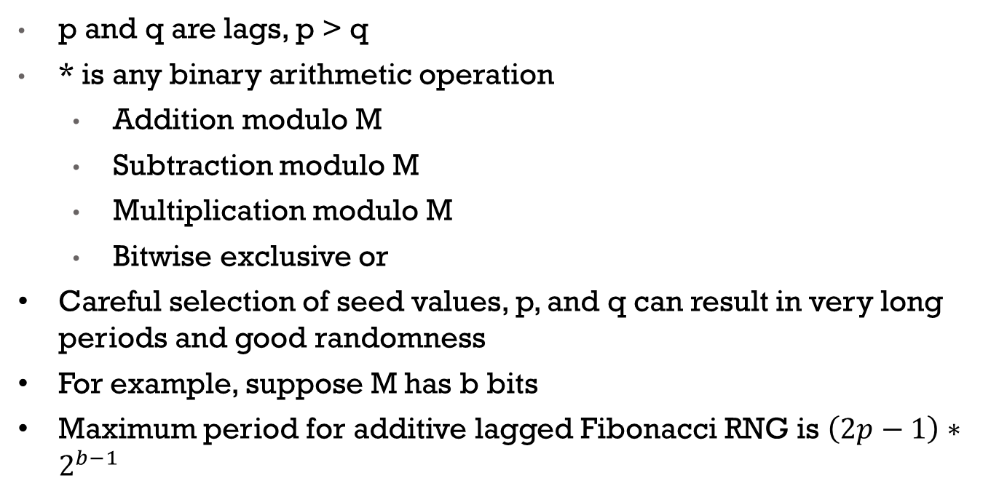
Lagged Fibonacci RNGs
p and q are lags, p > q
* is any binary arithmetic operation
Addition modulo M
Subtraction modulo M
Multiplication modulo M
Bitwise exclusive or
Careful selection of seed values, p, and q can result in very long periods and good randomness
For example, suppose M has b bits
Maximum period for additive lagged Fibonacci RNG is $\left(2p−1\right)∗2^{b−1}$

Slide 38
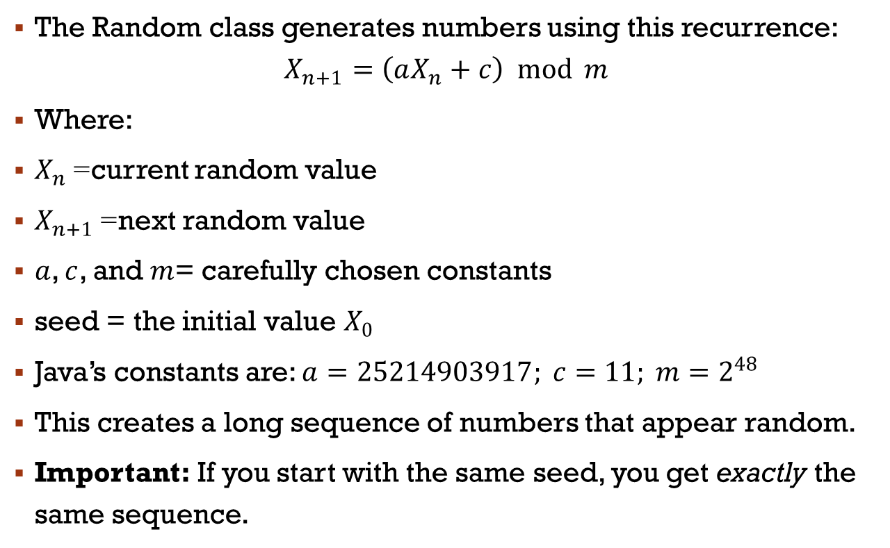
Random number in java
The Random class generates numbers using this recurrence:
$$X_{n+1}=\left(aX_{n}+c\right) mod m$$
Where:
$X_{n}$= current random value
$X_{n+1}$= next random value
$a$, $c$, and $m$= carefully chosen constants
seed = the initial value $X_{0}$
Java’s constants are: $a=25214903917; c=11; m=2^{48}$
This creates a long sequence of numbers that appear random.
Important: If you start with the same seed, you get exactly the same sequence.

Slide 39
Randomness in JavA
Randint()
Usueful data structure: ArrayList
Shuffle randomly an array (ArrayList)

Slide 40
The random java class
The Random class allow to generate random numbers.
The object is initialized with:
Random rand = new Random(seed); (seed in an integer)
Method | Returns | Typical Use
nextInt() | any int | general randomness
nextInt(bound) | int 0 to bound–1 | dice, indexes, cards
nextDouble() | double 0–1 | Monte Carlo weighting
nextBoolean() | true/false | random choices
nextFloat() | float 0–1 | graphics/games
nextLong() | any long | large random numbers
nextGaussian() | normal distribution | scientific simulations
setSeed(seed) | void | reproducible randomness
nextBytes(arr) | void | random data blocks

Slide 41
Arraylist in java
Dynamic arrays (based on linked lists..)
import java.util.ArrayList;
Unlike regular arrays (int[] arr), an ArrayList can:
Grow or shrink automatically
Store objects (not primitives)
Provide many useful methods for insertion, removal, searching, etc
ArrayList<String> names = new ArrayList<>();
Method | Meaning | Example
add(value) | Add element to end | list.add("Bob");
add(index, value) | Insert at position | list.add(1, "Alice");
get(index) | Read element | list.get(0);
set(index, value) | Modify element | list.set(0, "Tom");
remove(index) | Remove by index | list.remove(2);
remove(Object) | Remove first matching value | list.remove("Bob");
size() | Number of items | list.size();
contains(x) | Check existence | list.contains("Bob");
clear() | Remove all elements | list.clear();
To shuffle an ArrayList, use the shuffle() method of the class Collections (see demo ArrayList in java)

Slide 42

Java demos
RandomTest.java
ArrayListDemo.java
FourOfAKindMonteCarlo.java
MM simulation to find the probability to get a 4-of-a-kind at Texas Hold’em
The exact solution (from maths) is about 0.168% (1 over 594):
RandomTest.java
ArrayListDemo.java
MonteCarloPI.java
DiceMonteCarloCI.java

